Slide 1
Linear Machines & SVM
Linear Machines
Notes:
Unit 4: Linear Machines & SVM
Module 1: Linear Machines

Slide 2

Objective
Objective
Define general linear classifiers
Notes:
Module 1: Defining the setup. Discuss the regression task in Supervised Learning)

Slide 3
Revisiting Logistic Regression
In Logistic Regression: given a training set of n labelled samples <x^{(i)}, y^{(i)} >, we learn P(y|x) by assuming a logistic sigmoid function.
➔ We end up with a linear classifier.
➔ g(x) = w^{t}x is called the discriminant function.
Notes:
Provide an example during lecture.

Slide 4
Linear Discriminant Functions
In general, taking a discriminative approach, we can assume some form for the discriminant function that defines the classifier.
➔ The learning task is to use the training samples to estimate the parameters of the classifier.

Slide 5
Linear Decision Boundaries
Linear discriminant functions give arise to liner decision boundaries
➔ linear classifiers or linear machines
We will use both notations:
g(x) = w^{t}x or g(x) = w^{t}x + w₀

Slide 6
Linear Machine for C>2 Classes
We can define C linear discriminant functions:
g_{i}(x) = w_{i}^{t}x, i = 1, 2, …, C
What is the decision rule for the classifier?

Slide 7
The Learning Task
Finding w_{i}, i = 1, 2, …, C
Let’s use the 2-class case as an example
For n samples x₁, …, x_{n}, of 2 classes ω₁ and ω₂ , if there exists a vector w such that g(x) = w^{t}x classifies them all correctly ➔ Finding w
i.e., finding w such that
w^{t}x_{i} ≥ 0 for samples of ω₁ and
w^{t}x_{i} < 0 for samples of ω₂,

Slide 8
Linear Separability
If we can find at least one vector w such that g(x) = w^{t}x classifies all samples
➔ We say the samples are linearly separable.
An example of not linearly separable in 2-D:

Slide 9
The Solution Region
There may be many different weight vectors that can all be valid solutions for a given training set
➔ The solution regions
If the solution vector is not unique, Which one is the best?

Slide 10
Solving for the Weight Vector
Consider the following approach: finding a solution vector which optimizes some objective function.
➔ We may introduce additional constraints for a “good” solution”
➔ Solving a constrained optimization problem.
Theoretical: Lagrange or Karush-Kuhn-Tucker.
In practice: e.g., gradient-descent-based search

Slide 11
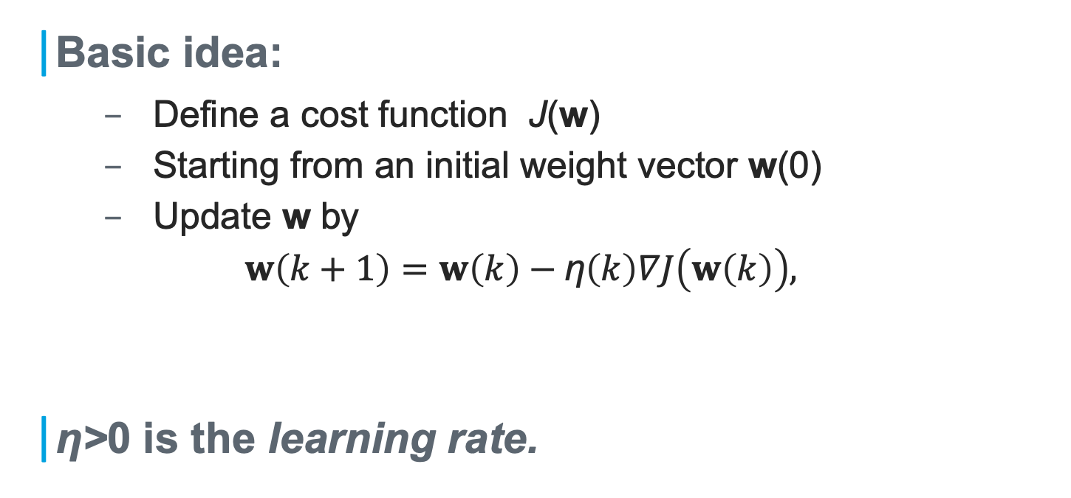
Gradient Descent Procedure
Basic idea:
Define a cost function J(w)
Starting from an initial weight vector w(0)
Update w by
$w\left(k+1\right)=w\left(k\right)−\text{η}\left(k\right)∇J\left(w\left(k\right)\right),$
η>0 is the learning rate.

Slide 13
Linear Machines & SVM
The Concept of Margins
Notes:
Unit 4: Linear Machines & SVM
Module 2: The Concept of Margins

Slide 14
Objective
Objective
Illustrate Margins in Classifier
Notes:
Module 1: Defining the setup. Discuss the regression task in Supervised Learning)

Slide 15
Illustrating Linear Boundaries
The decision boundaries is given by the line g(x) = 0.
For appreciating a geometric interpretation, we will write w₀ explicitly, i.e., we have
g(x) = w^{t}x + w₀
The normal vector of the decision line/plane is _________

Slide 16
Which one is better?
➔ Consider the distances of the samples to the decision plane.

Slide 17
Distance to the Decision Plane
X
g(x) = w^{t}x + w₀
w^{t}
X_{p}

Slide 18
Distance to the Decision Plane
X
g(x) = w^{t}x + w₀
w^{t}
X_{p}
g(x) gives an algebraic measure of the distance from x to the decision plane.

Slide 19
The Concept of Margins
Let g(x) = 0 be a decision plane
The margin of a sample x (w.r.t. the decision plane) is the distance from x to the plane.
For a given set of samples S, the margin (w.r.t a decision plane) is the smallest margin over all x in S.
For a given set, a classifier that gives rise to a larger margin will be better.

Slide 20
Use Margins to Compare Solutions
Max margin
SVM

Slide 21
Linear Machines & SVM
Linear SVM: Linearly Separable Case
Notes:
Unit 4: Linear Machines & SVM
Module 3: Linear SVM: Linearly Separable Case

Slide 22
Objective
Objective
Construct SVM for Linearly Separable Data
Notes:
Module 3: SVM for linearly separable data

Slide 23
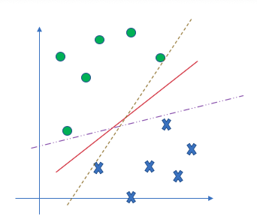
Key Idea of Support Vector Machines
For a given set, a classifier that gives rise to a larger margin will be better.
SVM: To find the decision boundary such that the margin is maximized.

Slide 24
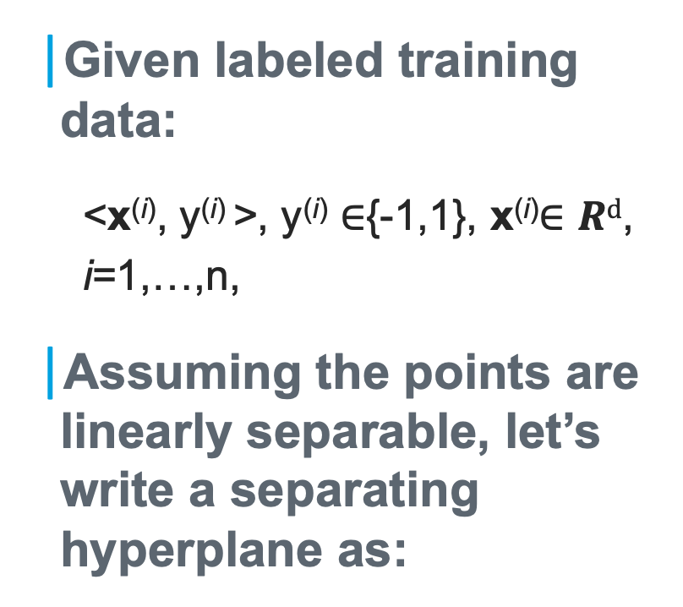
Formulating the Problem
Given labeled training data:
<x^{(i)}, y^{(i)} >, y^{(i)} $∈${-1,1}, x^{(i)}$∈Rd$,
i=1,…,n,
Assuming the points are linearly separable, let’s write a separating hyperplane as:
H: w^{t}x + b = 0

Slide 25
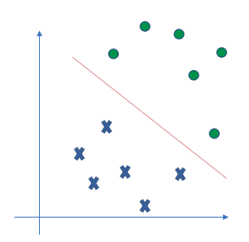
Formulating the Problem (cont’d)
Let d₊ (d₋) be the shortest distance from the separating hyperplane to the closest positive (negative) examples.
These defines planes H₁ and H₂.
We can let d₊=d₋=d
➔ Find a solution maximizing 2d.

Slide 26
Formulating the Margin
Given separating plane H: w^{t}x + b = 0 and distance d, what are the equations for H₁ and H₂?
Consider the plane H* given by w^{t}x + b = ||w||d
Check its orientation
Check its distance to H

Slide 27
Formulating the Margin (cont’d)
H₁ is given by w^{t}x + b = ||w||d
Similarly, H₂ is given by w^{t}x + b = -||w||d
Note: for any plane equation, w^{t}x + b = 0, {w, b} is defined only up to an unknow scale:
{sw, sb} is also a valid solution to the equation, for any constant s.

Slide 28

Formulating the Margin (cont’d)
We can have the canonical formulation for all the planes as
H: w^{t}x + b = 0
H₁: w^{t}x + b = 1
H₂: w^{t}x + b = -1
The region between H₁ and H₂ is also called the margin, and its width is $\frac{2}{|\left|w\right||}$

Slide 29
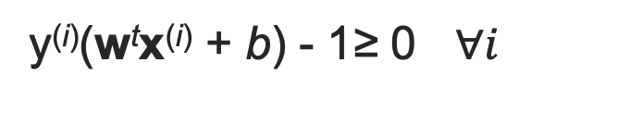
Formulating SVM
$\left\{w^{∗},b^{∗}\right\}=\underset{w, b}{argmin}\left\|w\right\| or$ $\left\{w^{∗},b^{∗}\right\}=\underset{w, b}{argmin}{\frac{1}{2}\left\|w\right\|2 }$
Subject to
w^{t}x^{(i)} + b ≥ 1 for y^{(i)} = +1
w^{t}x^{(i)} + b ≤ -1 for y^{(i)} = -1
The constraints can be combined into:
y^{(i)}(w^{t}x^{(i)} + b) - 1≥ 0 $∀i$
➔ A nonlinear (quadratic) optimization problem with linear inequality constraints.

Slide 30
How to solve SVM? (Outline)
Reformulate the problem using Lagrange multipliers α
Lagrangian Primal Problem
Lagrangian Dual Problem
The Karush-Kuhn-Tucker Conditions
Necessary and sufficient for w, b, α.
Solving the SVM problem ➔ finding a solution to the KKT conditions.
Notes:
Conditions that are satisfied at the solution of any constrained optimization problem (convex or not) with any kind of constraints, under reasonable assumptions (see Fletcher, 1987; McCormick, 1983).

Slide 31
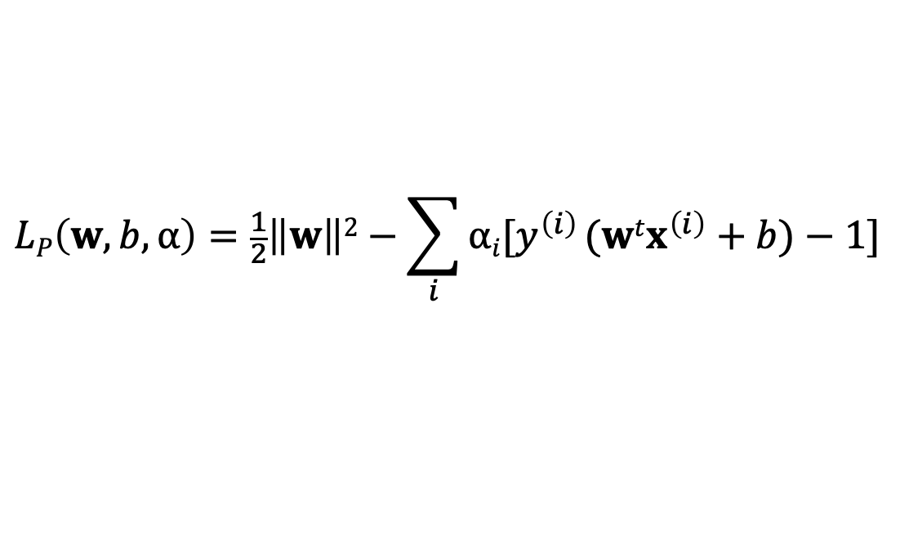
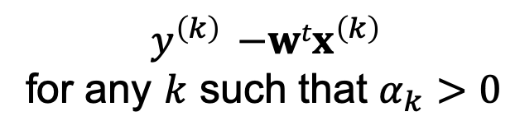
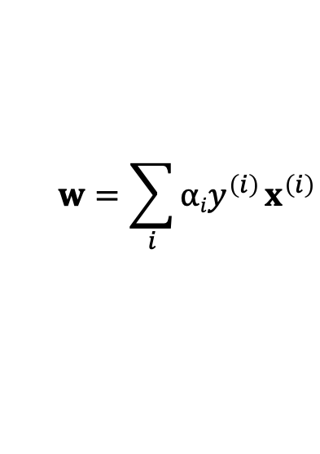
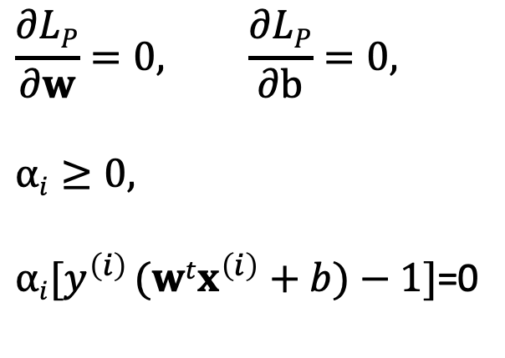
SVM: Lagrangian Primal Formulation
Define
then the SVM solution should satisfy
$$LP\left(w,b,α\right)=\frac{1}{2}\left\|w\right\|2−\sum_{i}{αi[y^{\left(i\right)} (wtx^{\left(i\right)}+b)−1]}$$
$$\frac{∂LP}{∂w}=0, \frac{∂LP}{∂b}=0,$$
$$αi≥0,$$
$αi[y^{\left(i\right)} (wtx^{\left(i\right)}+b)−1]$=0
The final w is given by
$$w=\sum_{i}{αiy^{\left(i\right)} x^{\left(i\right)}}$$
➔
and b is given by
$$y^{\left(k\right)} {−wtx}^{\left(k\right)}$$
for any $k$ such that $α_{k}>0$
Notes:
Conditions that are satisfied at the solution of any constrained optimization problem (convex or not) with any kind of constraints, under reasonable assumptions (see Fletcher, 1987; McCormick, 1983).

Slide 32
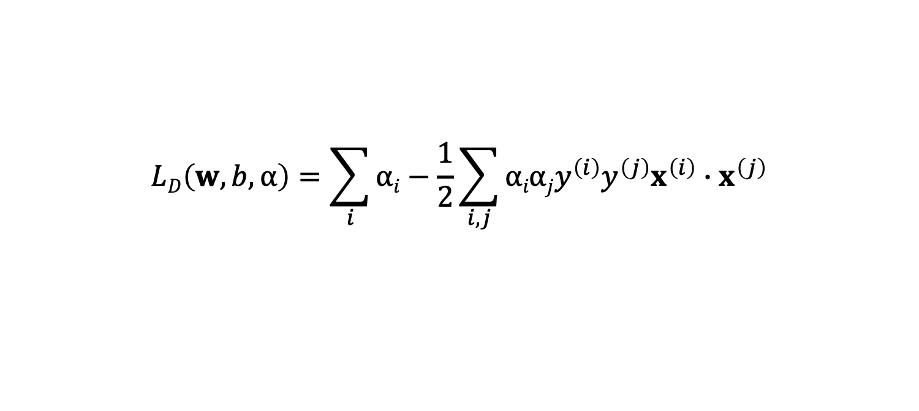
SVM: Lagrangian Dual Formulation
The objective function is
The solution is the same as before. But there is an important observation.
Points for which α_{i} > 0 are called support vectors
$$LD\left(w,b,α\right)=\sum_{i}{αi}−\frac{1}{2}\sum_{i,j}{αiαjy^{\left(i\right)}y^{\left(j\right)}x^{\left(i\right)}∙x^{\left(j\right)}}$$
Notes:
Conditions that are satisfied at the solution of any constrained optimization problem (convex or not) with any kind of constraints, under reasonable assumptions (see Fletcher, 1987; McCormick, 1983).

Slide 34
Linear Machines & SVM
SVM for Non-linearly-separable Case
Notes:
Unit 4: Linear Machines & SVM
Module 4: SVM: Non-Linearly-Separable case

Slide 35
Linear Separability Violated
Some samples will always be misclassified no matter what {w,b} is used.

Slide 36
Examining Misclassified Samples
They will violate the constraints:
w^{t}x^{(i)} + b ≥ 1 for y^{(i)} = +1
w^{t}x^{(i)} + b ≤ -1 for y^{(i)} = -1

Slide 37
Relaxing the Constraints
Introducing non-negative slack variables ξ_{i}
For an error to occur, the corresponding ξ_{i} must exceed unity.
Hinge loss or soft margin.
➔ ∑_{i} ξ_{i} provides an upper bound on the number of training errors.
w^{t}x^{(i)} + b ≥ 1- ξ_{i} for y^{(i)} = +1
w^{t}x^{(i)} + b ≤ -1+ ξ_{i} for y^{(i)} = -1
Notes:
Xi: zai.

Slide 38
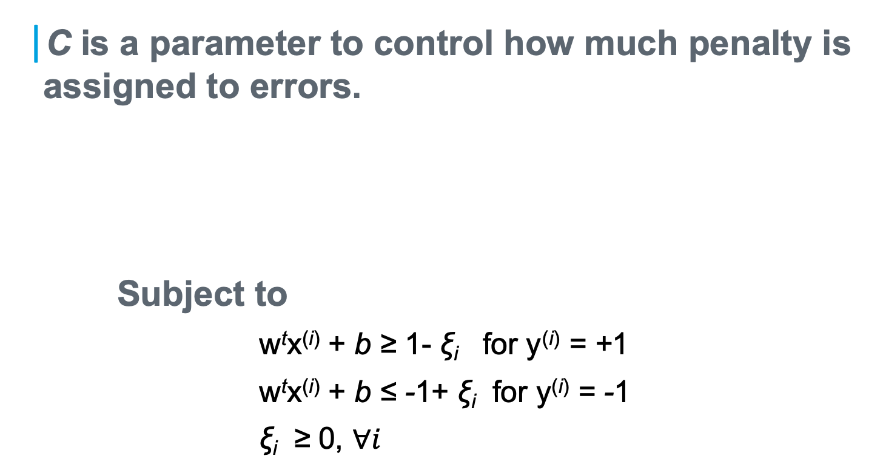
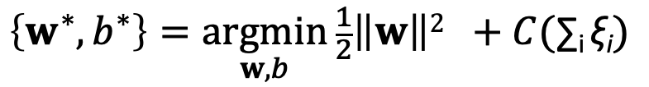
Updating the Formulation
C is a parameter to control how much penalty is assigned to errors.
Subject to
w^{t}x^{(i)} + b ≥ 1- ξ_{i} for y^{(i)} = +1
w^{t}x^{(i)} + b ≤ -1+ ξ_{i} for y^{(i)} = -1
ξ_{i} ≥ 0, $∀i$
$$\left\{w^{∗},b^{∗}\right\}=\underset{w, b}{argmin}{\frac{1}{2}\left\|w\right\|2 }+C(\text{∑}\text{i} \text{ξ}\text{i})$$

Slide 39
Are Non-linear Decision Boundaries Possible?
Transform data to higher dimensions using a mapping
More freedom to position the samples
May make the samples linearly separable
Run linear SVM in the new space ➔ may be equivalent to non-linear boundaries in the original space
What mapping to use?
Notes:
.

Slide 40
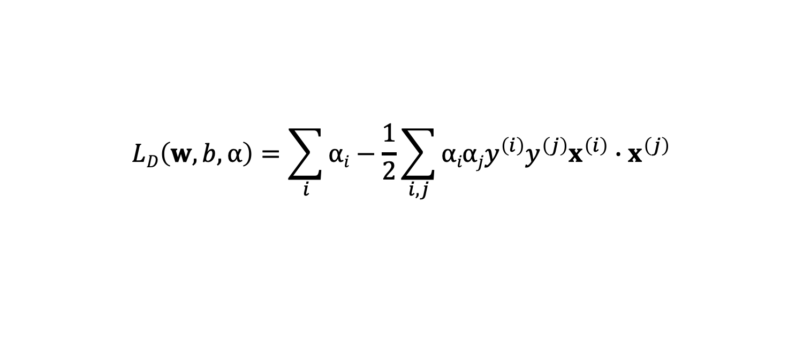
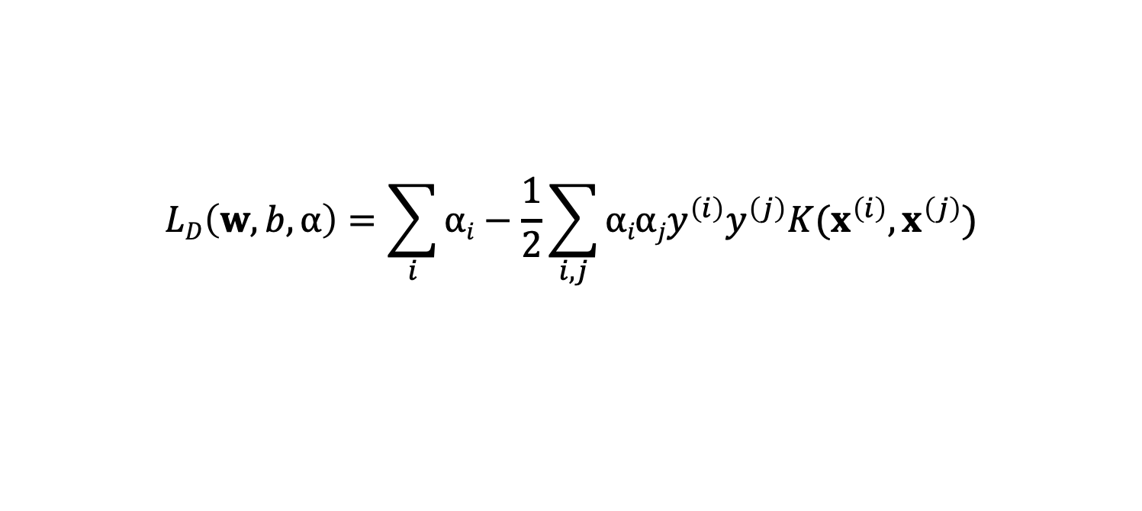
The Kernel Trick
Revisit the Lagrange Dual Formulation for SVM
Introduce a kernel function
$$LD\left(w,b,α\right)=\sum_{i}{αi}−\frac{1}{2}\sum_{i,j}{αiαjy^{\left(i\right)}y^{\left(j\right)}x^{\left(i\right)}∙x^{\left(j\right)}}$$
$$LD\left(w,b,α\right)=\sum_{i}{αi}−\frac{1}{2}\sum_{i,j}{αiαjy^{\left(i\right)}y^{\left(j\right)}{K(x}^{\left(i\right)},x^{\left(j\right)})}$$
Notes:
.

Slide 41
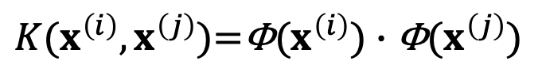
The Kernel Trick (cont’d)
Mercer’s Theorem: for a symmetric, non-negative definite kernel function satisfying some minor conditions, there exists a mapping Φ(x) such that
Using a kernel function in L_{D} can effectively defines an implicit mapping to a higher-dimensional space, where linear SVM was run.
The decision boundaries in the original space can be highly non-linear.
${K(x}^{\left(i\right)},x^{\left(j\right)})$=${\text{Φ}(x}^{\left(i\right)})∙\text{Φ}(x^{\left(j\right)})$
Notes:
.

Slide 42

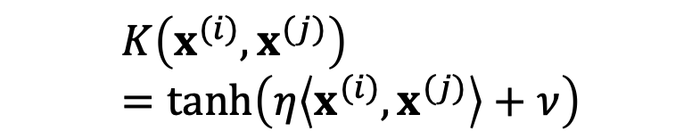
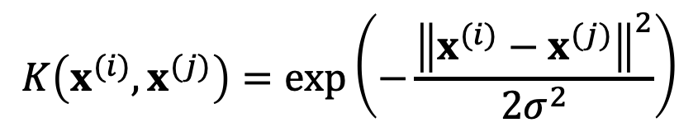

Common Kernel Functions
Polynomials of degree d
Polynomials of degree up to d
Gaussian kernels
Sigmoid kernel
$$K\left(x^{(i)},x^{(j)}\right)={\left\langle x^{(i)},x^{(j)}\right\rangle }^{d}$$
$$K\left(x^{(i)},x^{(j)}\right)=({\left\langle x^{(i)},x^{(j)}\right\rangle +1)}^{d}$$
$$K\left(x^{(i)},x^{(j)}\right)=\text{exp}\left(−\frac{{\left\|x^{(i)}−x^{(j)}\right\|}^{2}}{2σ^{2}}\right)$$
$$K\left(x^{(i)},x^{(j)}\right)=tanh\left(η\left\langle x^{(i)},x^{(j)}\right\rangle +ν\right)$$
Notes:
.

